Slide 1

Welcome to our
Handwriting Workshop
Notes:
Right click on the grey box and ‘Change picture’ to your school logo.
Or delete grey box and type in your school name.

Slide 2
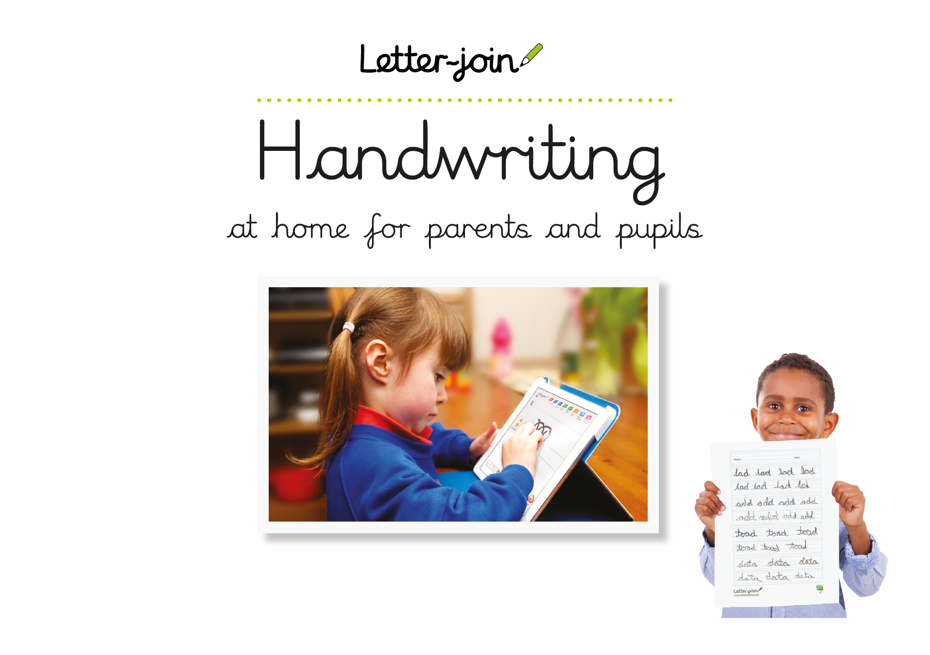

Handwriting at at our school
We use Letter-join which teaches handwriting in line with the National Curriculum.
• Early Years - Reception
• Key Stage 1 - Years 1/2
• Key Stage 2 - Years 3/4/5/6
You can download a PDF of the Letter-join brochure to read on screen or print out.
Notes:
By the end of each key stage:
Early Years: children should be able to hold and use a pencil to form recognisable lowercase letters.
KS1: children should be able to write legibly with clear descenders and ascenders and use upper and lowercase letters appropriately.
KS2: children should be able to maintain fluent and legible joined handwriting when writing at speed.

Slide 3
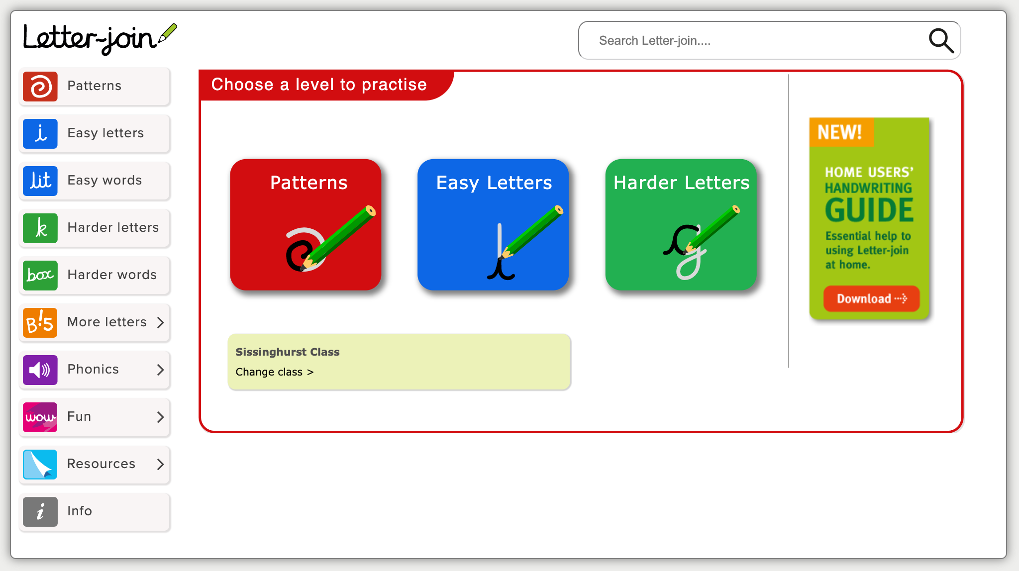
Letter-join Handwriting Scheme
Letter-join is a whole school handwriting scheme used in all classes to achieve consistent progression in handwriting.
It has:
• animations to demonstrate letter formation and joining techniques.
• games and activities to practise handwriting as well as phonics and spelling.
• worksheets for real handwriting practice which can be copied into handwriting books.
Notes:
We will look at the website’s resources more closely later on.
Letter-join is a whole school handwriting scheme used in all classes to achieve consistent progression in handwriting.
It has:
• animations to demonstrate letter formation and joining techniques.
• games and activities to practise handwriting as well as phonics and spelling.
• worksheets for real handwriting practice which can be copied into handwriting books.

Slide 4
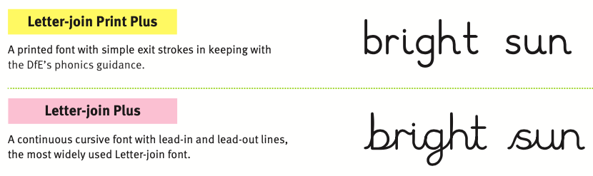
Handwriting at our school
our chosen handwriting style
we use lead-in and lead-out lines
use lowercase letters, not capitals
Notes:
Before the presentation, drop in a screenshot of your school’s lowercase letter formation (Resources > Printouts > Posters and Handouts > Your chosen class font)
Point out your choices for the letters f, k, w, x and z.
Point out your handwriting style (printed, lead-in or no lead)
Explain that they should not encourage their children to learn to write using capital letters.

Slide 5
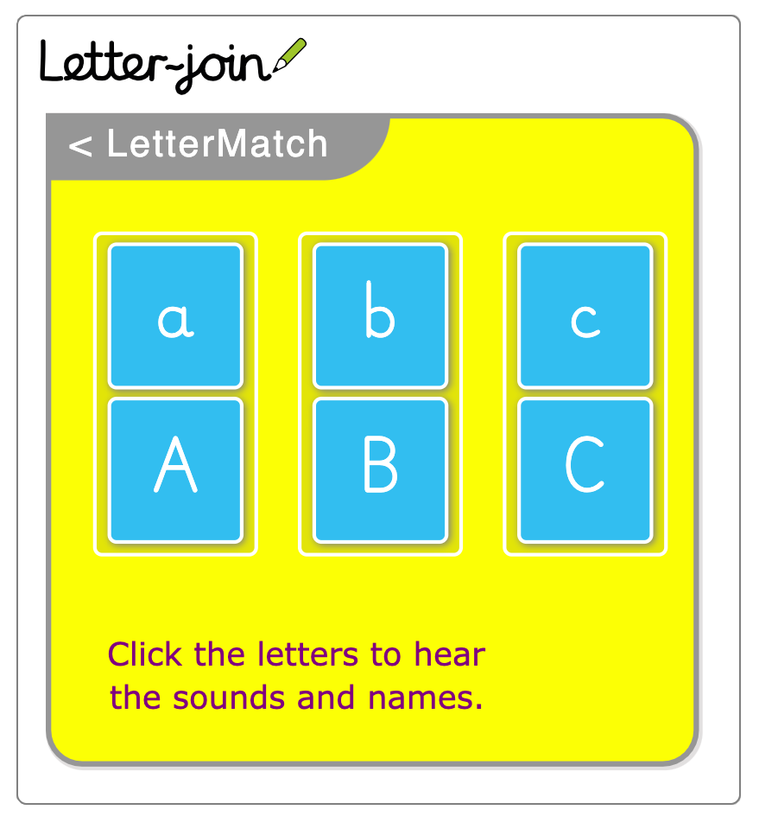
Handwriting at our school
our chosen handwriting style
we use lead-in and lead-out lines
use lowercase letters, not capitals
refer to letters with their sound not their name
Notes:
Parents should refer to lowercase letters with their sound, not the name of the letter.
You will demonstrate LetterMatch later which models the letter sounds.

Slide 6
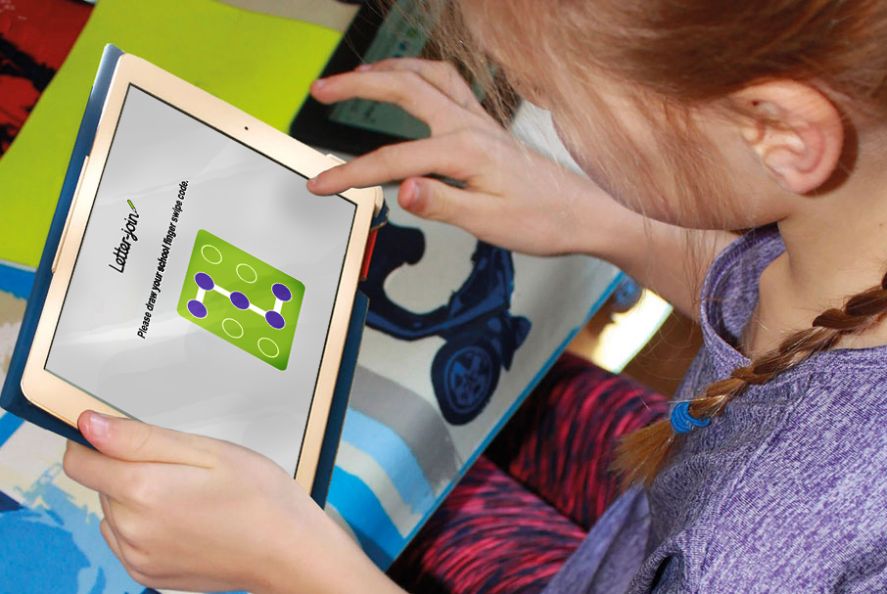
Letter-join Handwriting Scheme
You can use Letter-join at home on PCs and tablets.
Notes:
Our subscription includes a Pupil log-in so you can access the website and all the resources at home.
Children can copy the worksheets into handwriting books or print them out.

Slide 7

Letter-join log-in
All children use same log-in details.
Choose your child’s class to access:
  the correct handwriting style
  class word banks
  home learning tasks
Notes:
Before the presentation, log in to your Pupil Account and make a screenshot of your class names to replace this image, if desired.
Note that if parents have children in different classes, they can change the class from the home page of the Pupil Account.

Slide 8
Making the most of Letter-join at home
Log in to Letter-join
  Patterns
  Easy letters
  Easy words
  Harder letters
  Harder words
  More letters
Notes:
Show how to log in to a Pupil account and demonstrate the Letter-join resources.

Slide 9
Thank you for attending our
Handwriting Workshop
Notes:
Right click on the grey box and ‘Change picture’ to your school logo,
r delete grey box and type in your school name.

