Slide 1

St. Gregory’s Catholic Primary School
Together, in Jesus, we Love, Learn, Create and Celebrate!
PSHE – Theme and Content Overview
‘Jesus said: “love your neighbour as
yourself”’.
(Mark 12:31)
‘Do your work and be happy as if you were serving God.’
(Colossians 3:23)
‘I praise you God for I am fearfully and wonderfully made.’
(Psalm 139:14)
At St. Gregory’s Catholic Primary School, our commitment to nurturing the whole child is at the heart of everything we do. Our Fullness of Life – Personal Development Curriculum ensures that each pupil is supported in growing into a confident, compassionate individual who is ready to make a positive contribution to the world.
As part of our weekly Personal Development lessons, we use the NHS-backed myHappymind+ programme to help children build self-esteem, resilience, and empathy. These sessions complement our Relationships and Sex Education (RSE) programme, A Journey in Love, alongside No Outsiders and our Social Signature offer—creating a comprehensive and values-driven approach to personal growth.
This implementation guide supports the delivery of myHappymind+ across the academic year. The programme consists of four core strands:
myHappymind – green
myHappybody – blue
myHappyrelationships – purple
myHappyworld – yellow
Each module is aligned with the PSHE curriculum and organised by Key Stage, allowing flexibility in delivery to suit the unique needs of each cohort. At St. Gregory’s, this flexibility supports our tailored approach to Personal Development, ensuring every child receives the support they need to flourish.
To accommodate our Fullness of Life offer, the myHappymind+ long-term plan includes buffer weeks throughout the year. These provide time for No Outsiders, RSHE, enrichment activities, or the delivery of additional content not covered by myHappymind+, where appropriate to the cohort. Staff are encouraged to use these weeks to embed learning and reinforce our school values.
This plan is a supportive framework—not a rigid structure. We encourage staff to adapt the sequence of modules where appropriate, while ensuring the core principles of the myHappymind+ programme remain central to the delivery of our Fullness of Life curriculum.
At St. Gregory’s, we strive to create a learning environment where children feel safe, valued, and inspired to be their best. myHappymind+ plays a key role in this vision, helping every pupil prepare for a bright and fulfilling future.

Slide 2
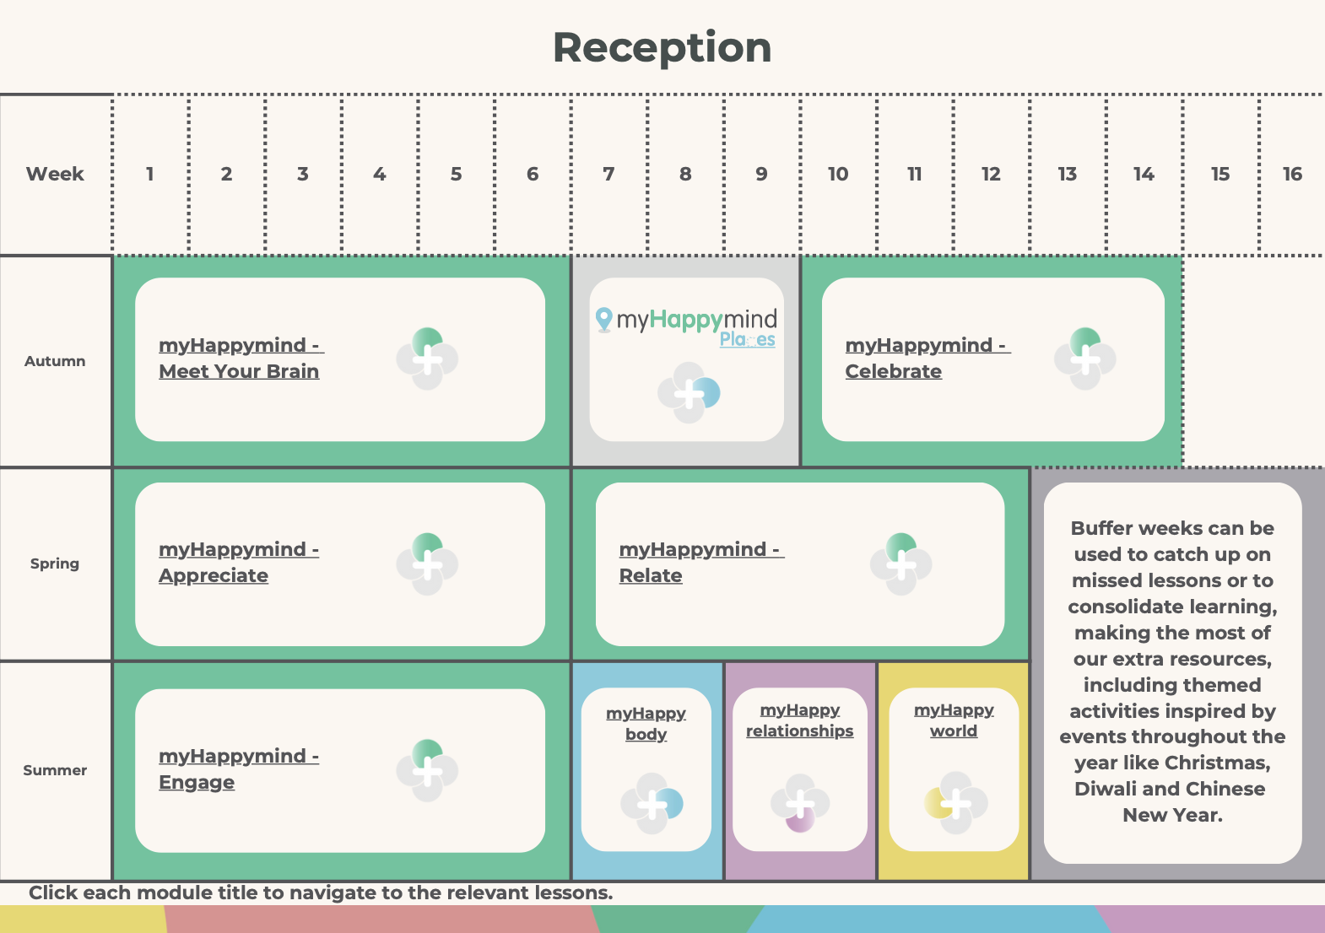
St. Gregory’s Catholic Primary School
Together, in Jesus, we Love, Learn, Create and Celebrate!

Slide 3
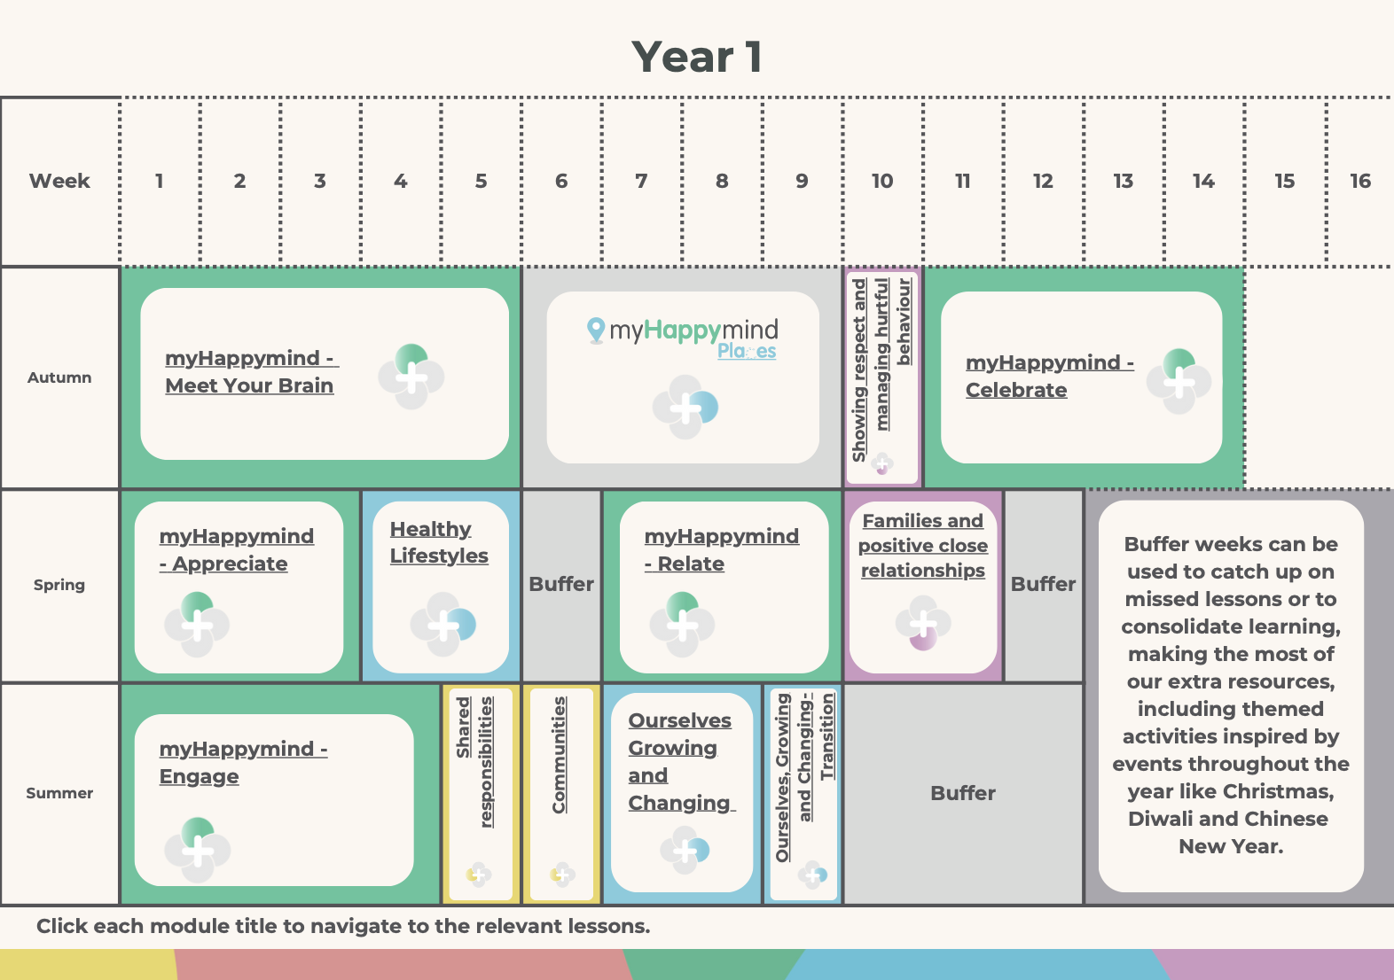
St. Gregory’s Catholic Primary School
Together, in Jesus, we Love, Learn, Create and Celebrate!

Slide 4
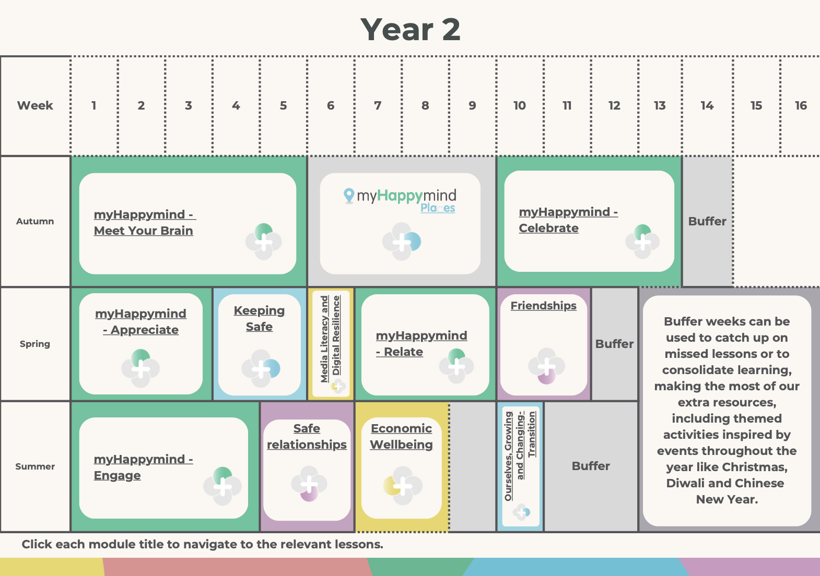
St. Gregory’s Catholic Primary School
Together, in Jesus, we Love, Learn, Create and Celebrate!

Slide 5
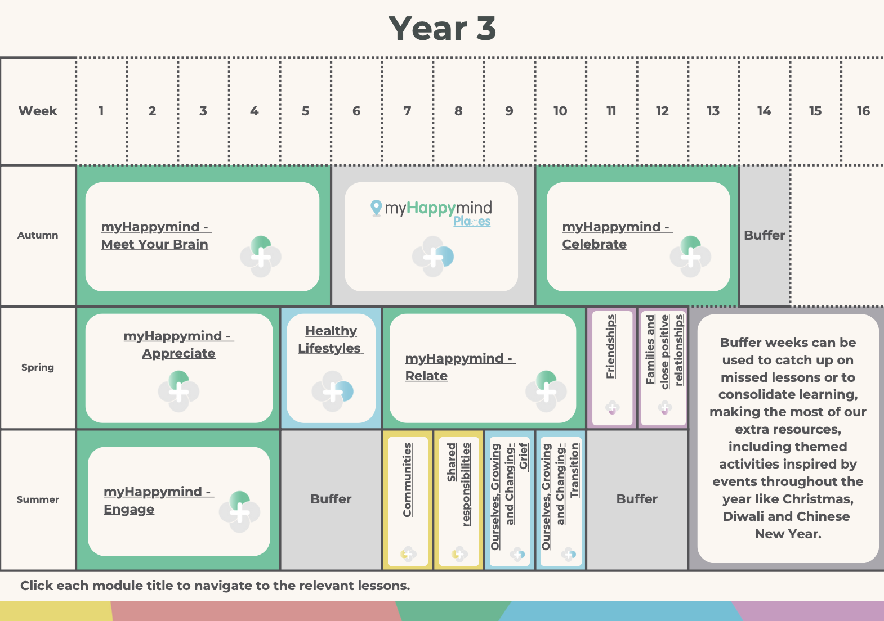
St. Gregory’s Catholic Primary School
Together, in Jesus, we Love, Learn, Create and Celebrate!

Slide 6
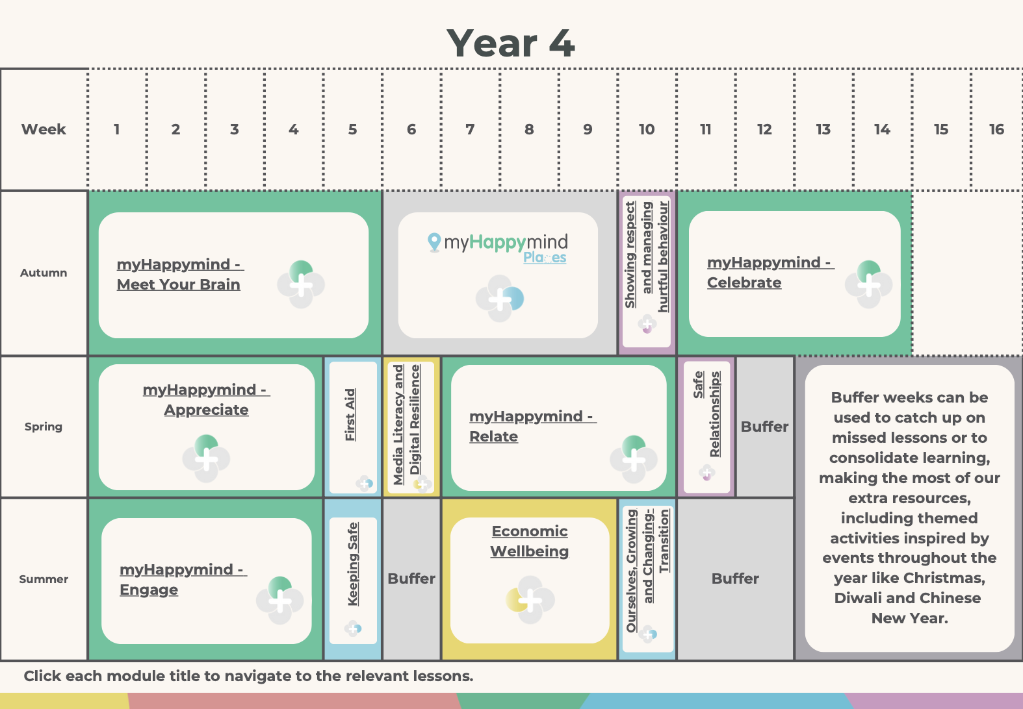
St. Gregory’s Catholic Primary School
Together, in Jesus, we Love, Learn, Create and Celebrate!

Slide 7
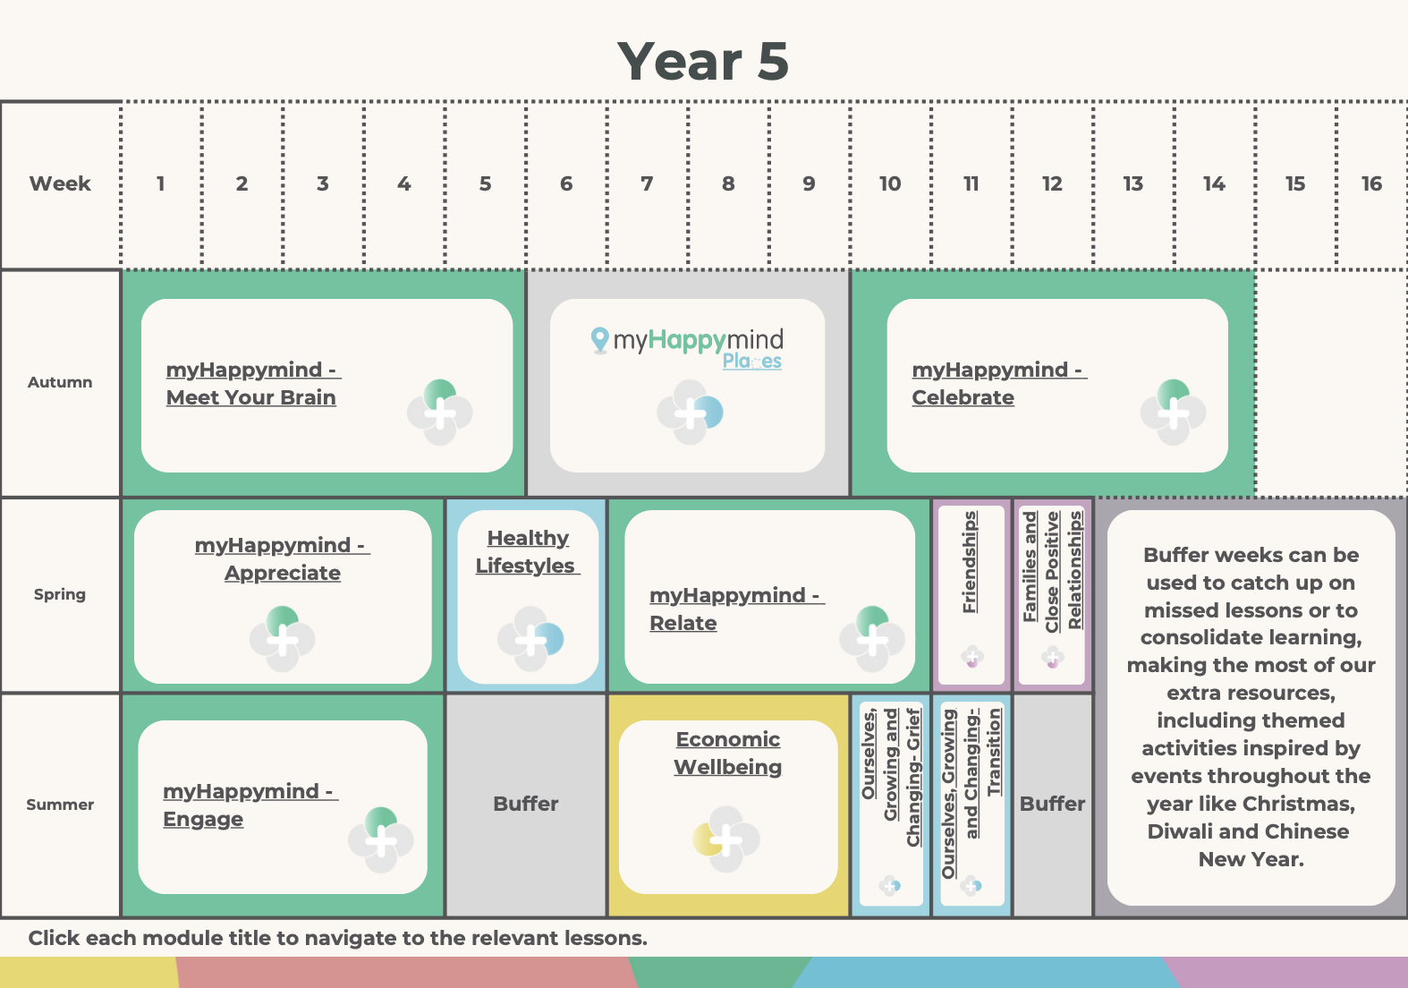
St. Gregory’s Catholic Primary School
Together, in Jesus, we Love, Learn, Create and Celebrate!

Slide 8
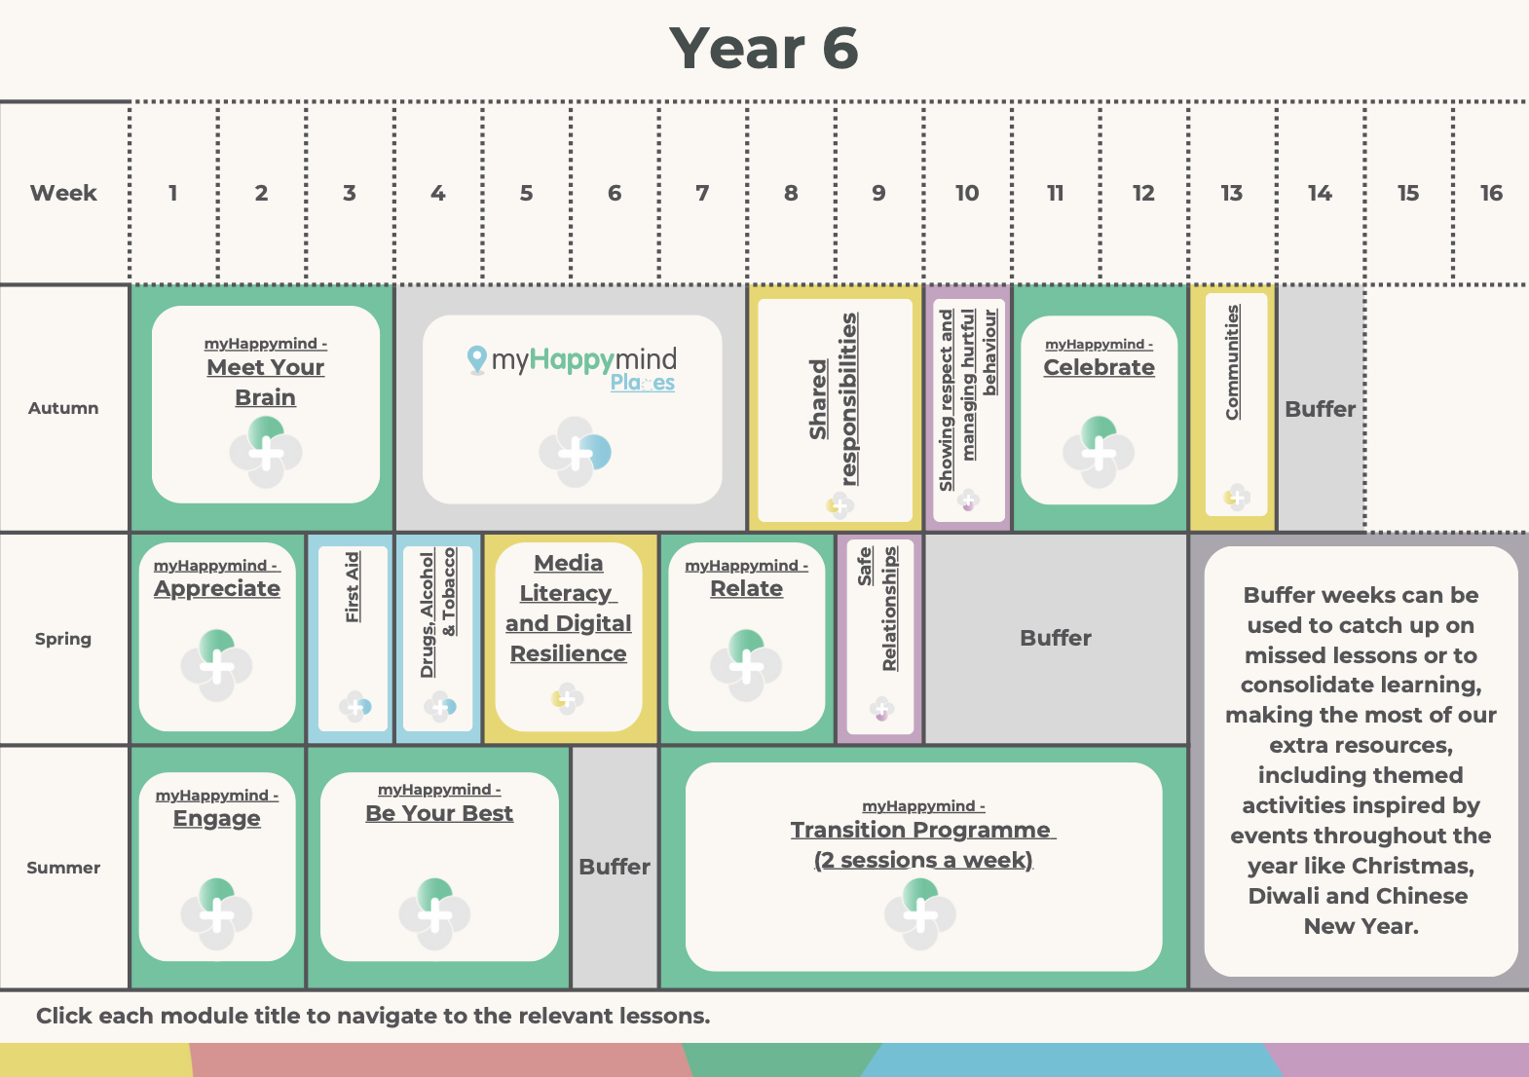
St. Gregory’s Catholic Primary School
Together, in Jesus, we Love, Learn, Create and Celebrate!

